Slide 1
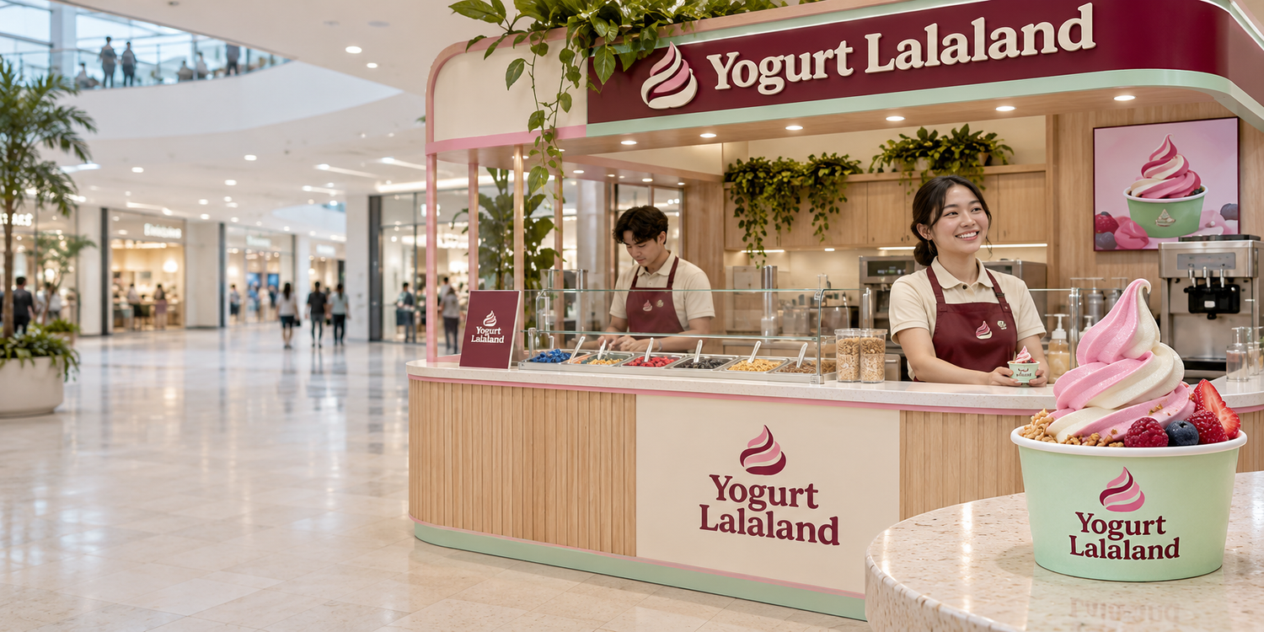

A family treat
made in Qatar
Company profile
Mall leasing and partnerships
Make it your swirl.

Slide 2
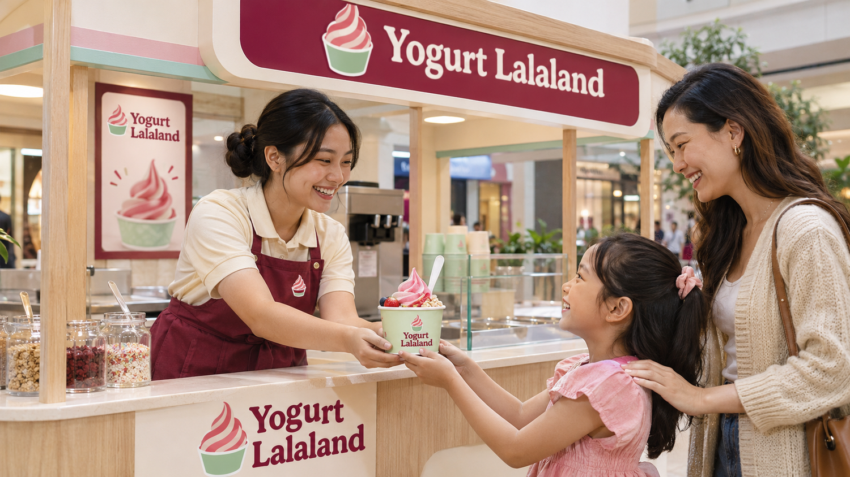
01 / WHO WE ARE
A local brand for family outings
A Qatar-born kiosk brand built around a treat children can make their own.
Lalaland takes its name from the world of children’s imagination. Our mall kiosk format gives families an easy stop during their visit.
Little choices make sweet memories.
YOGURT LALALAND / COMPANY PROFILE
02

Slide 3
02 / CUSTOMER EXPERIENCE
Four steps to build a swirl
An ordering flow families can follow at the counter or on screen.
01 ▱
02 ∿
03 ✦
04 +
Choose a cup
Pick a swirl
Add toppings
Make it yours
Start with the size that suits you.
Choose a frozen yogurt flavor.
Give your cup texture and color.
Finish with an extra or name your creation.
YOGURT LALALAND / COMPANY PROFILE
03

Slide 4
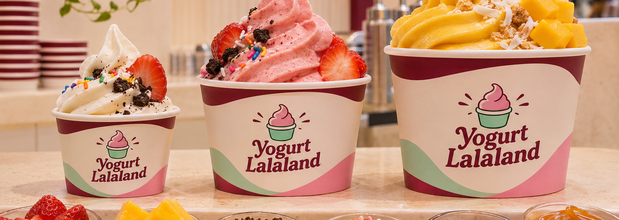
03 / PRODUCTS
Frozen yogurt, toppings and extras
Cup sizes / Flavors / Toppings / Sauces
Your favorites, all in one cup.
YOGURT LALALAND / COMPANY PROFILE
04

Slide 5
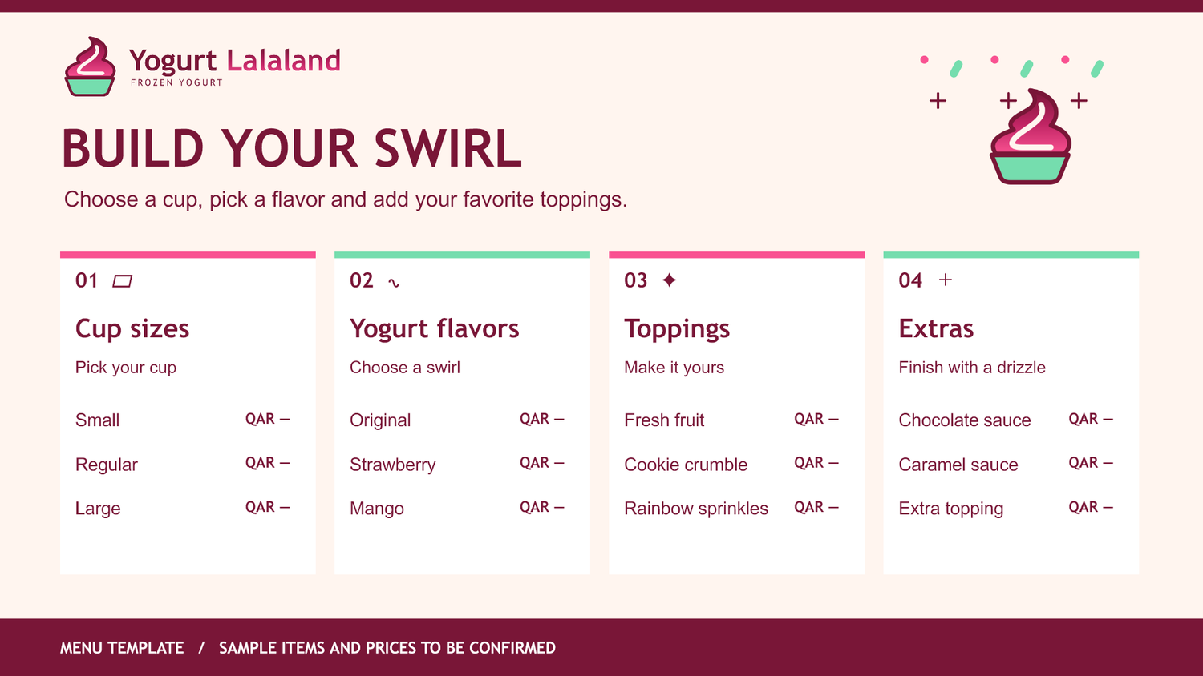
04 / MENU SYSTEM
A menu built for quick decisions
One ordering structure for kiosk screens, counter menus and the website.
Sample items and prices are subject to confirmation.
YOGURT LALALAND / COMPANY PROFILE
05

Slide 6
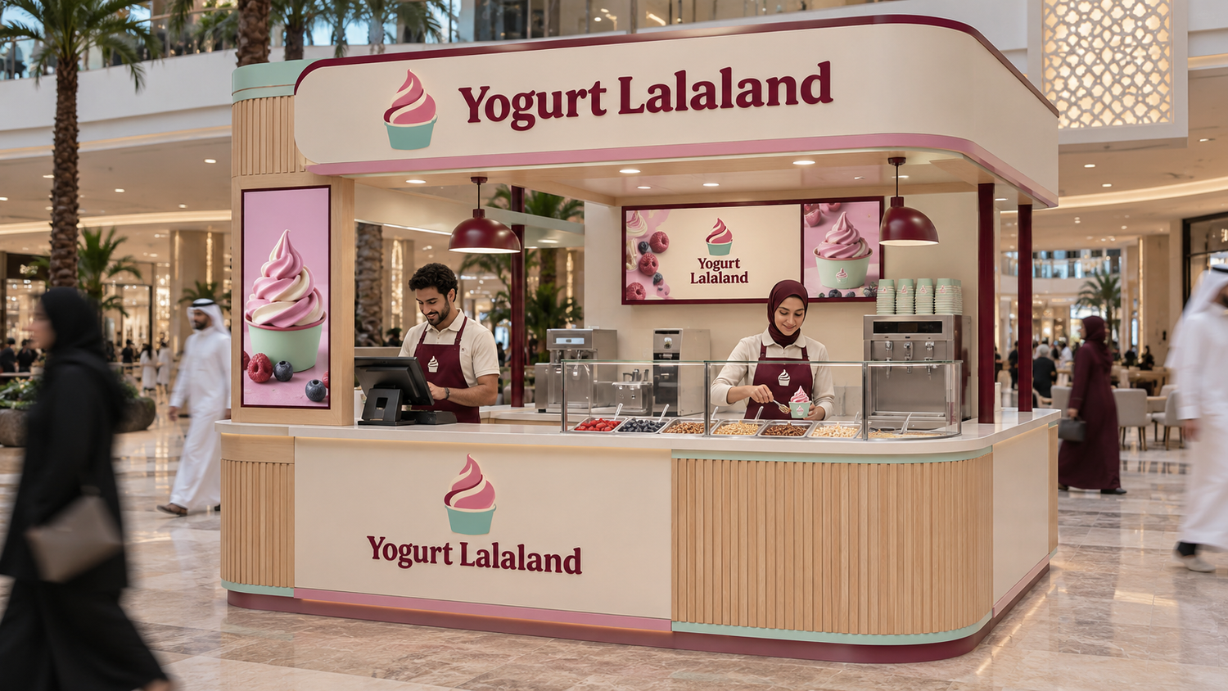
05 / LOCATIONS AND EXPANSION
Two Qatar locations and room to grow
West Walk
Al Waab City
Kiosk concepts shown. Confirm exact kiosk positions and hours before publication.
Expansion focus: additional mall locations with family traffic and space for a clear queue.
YOGURT LALALAND / COMPANY PROFILE
06

Slide 7
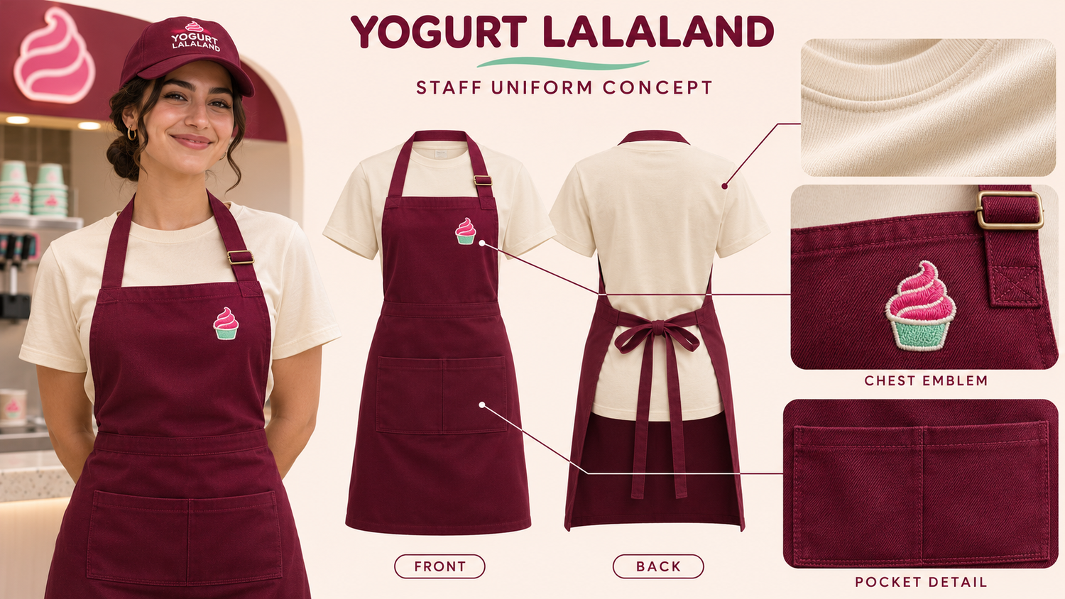
06 / TEAM AND UNIFORM
A consistent welcome at the counter
Cream shirt
Burgundy apron
Chest emblem
• A warm welcome
• Clear ordering guidance
• Patient service for families
A warm welcome in Lalaland colors.
YOGURT LALALAND / COMPANY PROFILE
07

Slide 8
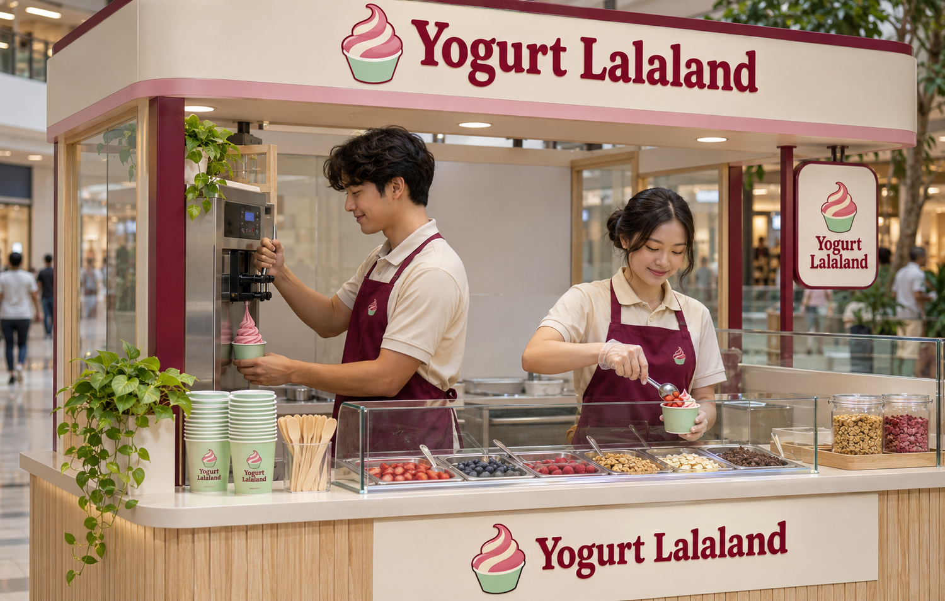
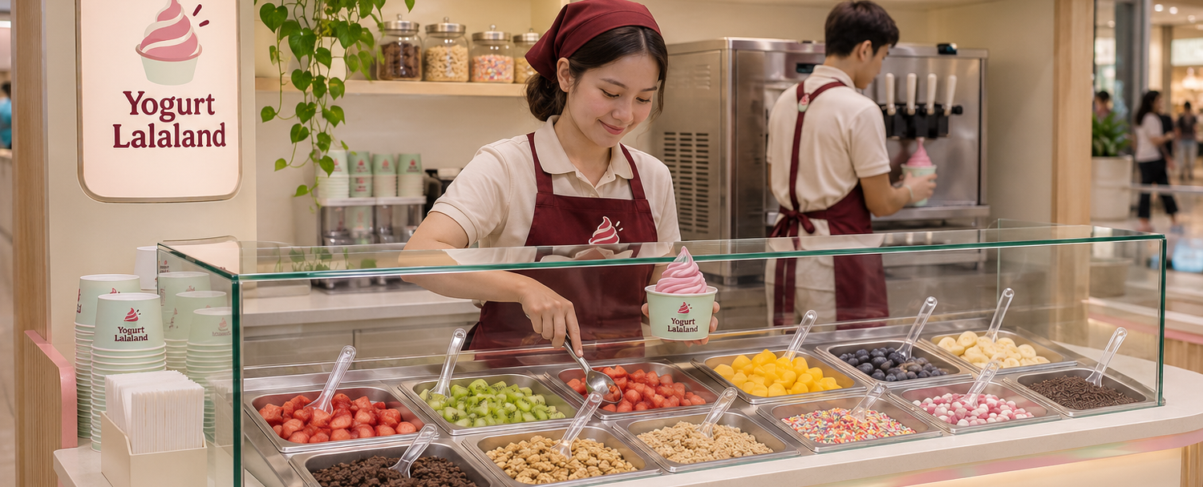
07 / OPERATING CONCEPT
A kiosk built for mall visits
Site planning
• Visible kiosk placement
• Room for a clear queue
• Utilities and delivery access
Daily service
• Tidy counters
• Carefully handled toppings
• Clear ingredient guidance
Care behind every swirl.
YOGURT LALALAND / COMPANY PROFILE
08

Slide 9
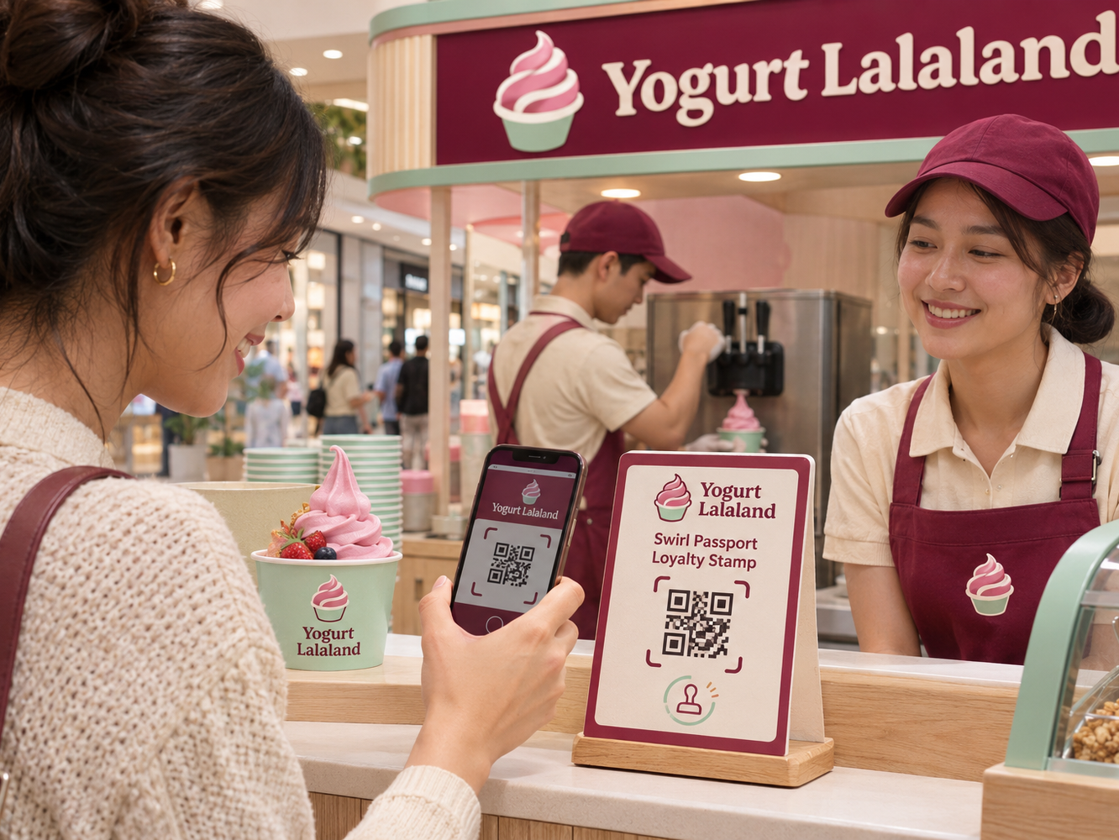
08 / DIGITAL AND LOYALTY
The website and Swirl Passport
Bilingual website
English and Arabic pages cover products, locations, jobs and partnership enquiries. Visitors can download the profile or contact us through WhatsApp.
Swirl Passport
Swirl Passport is in development. The idea is simple: scan at the counter to collect a digital stamp on eligible visits.
A little something for the next visit.
YOGURT LALALAND / COMPANY PROFILE
09

Slide 10
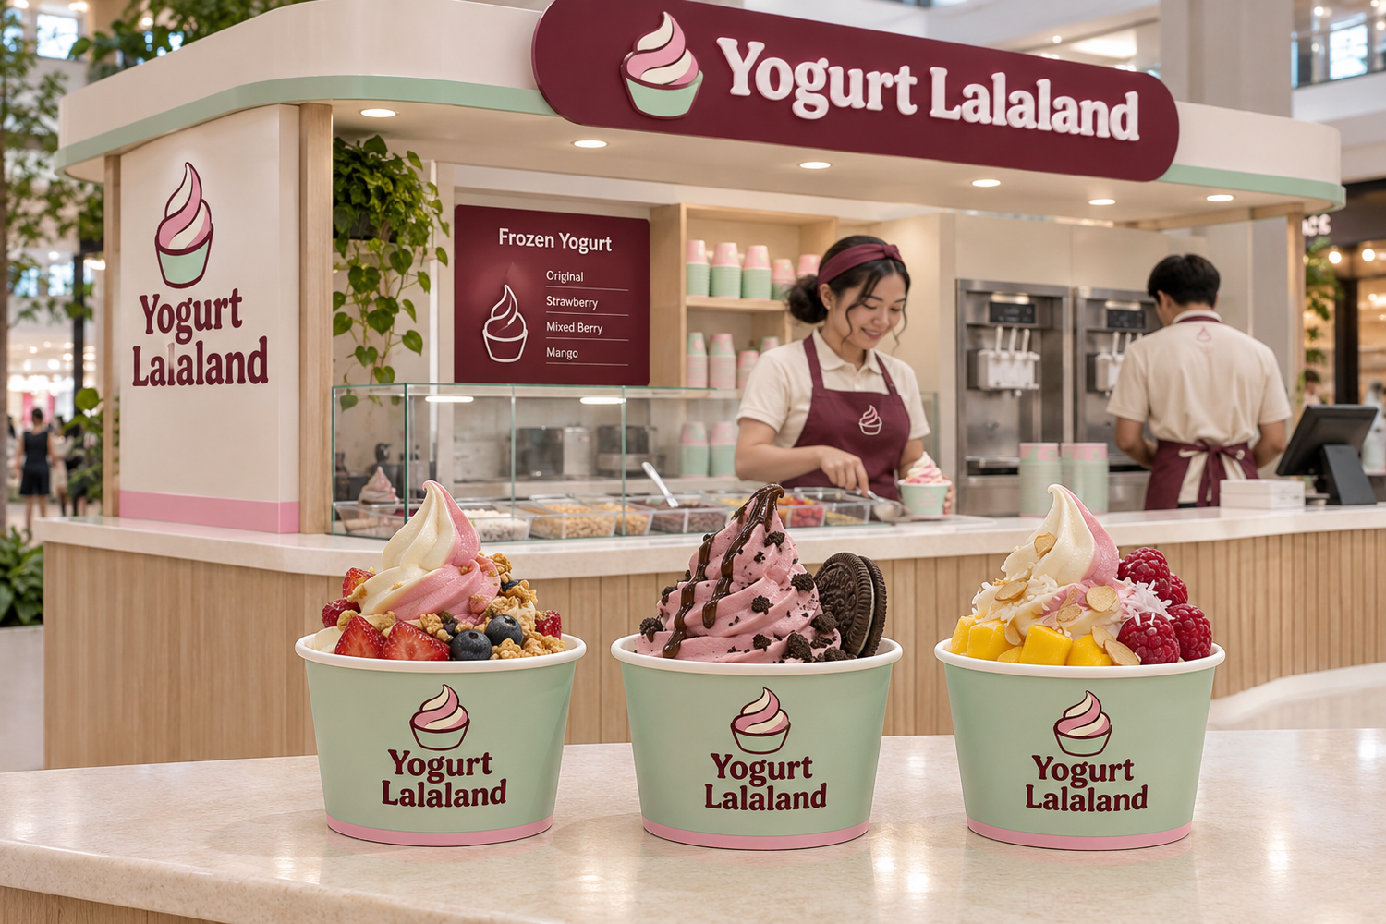
09 / PR AND LOCAL CREATORS
Qatar creator partnerships
01
Preview
Invite Qatar-based family and food creators for a kiosk visit.
02
Share
Agree on disclosures, filming permission and content usage.
03
Measure
See which stories bring families to the kiosk and build on those partnerships.
A taste worth sharing.
YOGURT LALALAND / COMPANY PROFILE
10

Slide 11
10 / MALL LAUNCH
How we can open together
01
02
03
Review the site
Make it feel like Lalaland
Plan launch
• A visible spot
• A comfortable queue
• Space for signs and utilities
Equipment schedule, approvals and operating requirements.
• Mall announcements
• Local creator previews
• Opening-day promotion
Let us plan an opening that gives families a reason to stop by.
YOGURT LALALAND / COMPANY PROFILE
11

Slide 12


Leasing and franchise enquiries
ask@qyogurt.com
+974 6697 2114 / +974 6006 7800
+974 5538 7310

